Slide 1

EV INDUSTRY CHARGING RECOMMENDATION DASHBOARD

Slide 2

AGENDA
PART 1
PART 2
BUSINESS CONTEXT
PROBLEM DEFINITION
1. Industry & Company Examples
2. Business Background
3. Business Problem
4. Why Existing Fail
5. Business Impact
6. Problem Statement: Build Excel Recommendation Dashboard
7. Business Objectives: Reduce search <2 min, 0% stranded
PART 3
PART 4
SOLUTION DESIGN
IMPACT & DELIVERABLES
8. Functional Requirements
9. Non-Functional Requirements & Data Required
10. Tech Stack: Excel Tables + Named Ranges + Haversine
11. KPIs: Reachable 25.0%, Avg Distance Top5 29.9km
12. Business Outcome: Load balancing, CSAT up & Deliverables

Slide 3













1. INDUSTRY & COMPANY EXAMPLES
POINT 1 — INDUSTRY FOCUS
POINT 2 — COMPANY EXAMPLES
EV INDUSTRY / E-MOBILITY INFRASTRUCTURE — CHARGING OPTIMIZATION
CPOS FACING SAME DISCOVERY
& LOAD PROBLEM
Tata Power EZ Charge 5K+ stations
Statiq
ChargeZone
Bolt.Earth
1
$113B
1,548
68%
Ather Grid
Zeon
India market by 2029 — CAGR 49%
Raw dataset stations • 12K+ nationally
Users cite range anxiety #1 barrier
2
T
Tata Power EZ Charge: Shows availability but no personalized score — no battery-on-arrival calc.
S
Statiq + ChargeZone: Real-time status, but ignores user's current battery %, range, queue fusion.
Problem cluster — Station discovery & utilization imbalance, not just availability.
A
Common gap: All show distance only — need weighted Distance (40%) + Queue (30%) + Battery (30%)
Our Excel solves exact gap for all CPOs: pure formula MVP before investing in APIs.

Slide 4













2. BUSINESS BACKGROUND
1,548+
170% YoY
Stations in raw dataset • 12K+ nationally • State spread 28 states
EV adoption surge, but 68% cite range anxiety #1 barrier
CURRENT DRIVER JOURNEY = BROKEN
🔋 Low Battery (20%)
→
🗺️ Open Maps
→
📍 See 10 stations
→
❓ Which one? No queue / no battery-on-arrival
📍
Our dataset — Karnataka focused, Mangalore demo: EVRawDataset lat/long validated, EVCleanedDataset adds Distance via Haversine 6371*ACOS(), Queue = MOD(ROW*7,10), Battery Arrival = MAX(0,70 - Dist/300*100). MyLat 12.9090 • MyLong 74.8359 • MyCity Named Range.
MANGALORE • LIVE DEMO CITY
12.9N, 74.8E
Mescom Surathkal
70% Battery
1.4 vehicles
Nearest 11.4 km Score 89.68
Dash + Phone sync
Avg queue Top5

Slide 5
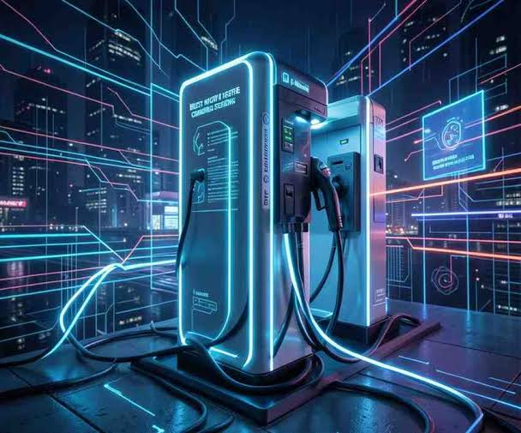






3. BUSINESS PROBLEM
CORE PROBLEM • NO PERSONALIZED RANKING
Existing apps show distance only. Drivers must mentally fuse distance + queue + battery-on-arrival — and they guess wrong.
SCENARIO • WHAT USER SEES TODAY
OPTIMAL • WHAT OUR ENGINE FINDS
STATION A • 2 KM AWAY
STATION B • 5 KM AWAY
Distance: 2.0 km ✓ nearest
Distance: 5.0 km but still reachable
Queue: 8 vehicles — hidden
Queue: 0 vehicles
Battery on arrival: 68% — not shown
Battery on arrival: 63%
⚠ Wrong choice
✓ Best Score 87.3
TECHNICAL GAP → MUST FUSE 3 SIGNALS
📍
🔋
⏱️
User Impact: wrong choice = stranded, 45 min extra wait, battery depletion. Operator impact: congestion imbalance.
REAL USER JOURNEY — MANGALORE DEMO
LOW BATTERY → OPEN MAPS → SEE 10 STATIONS → WHICH ONE? NO CONTEXT.

Slide 6











4. WHY EXISTING SOLUTIONS FAIL
GOOGLE MAPS SHOWS DISTANCE ONLY — NO QUEUE, NO BATTERY-ON-ARRIVAL, NO PERSONALIZED SCORE
GOOGLE MAPS
LOW
TATA POWER APP
MEDIUM
STATIQ APP
MEDIUM
OUR EXCEL SOLUTION
HIGH
SHOWS
SHOWS
SHOWS
SHOWS
Distance only
Availability
Real-time status
Distance + Queue + Battery + Reachability + Score
GAP
GAP
GAP
No queue, no battery, no reachability
No personalized score, no battery arrival
Ignores user's battery range, no Score>50 flag
LOGIC
Weighted MCDM: 0.4 Dist + 0.3 Queue + 0.3 Battery
✕
Cannot fuse Battery % + Queue + Distance
!
Static list, same for all users
!
No Haversine + Battery fusion
✕
No weighted MCDM scoring
✕
No LARGE() + INDEX-MATCH Top5
✓
Score = ((1-D/Max)*0.4 + (1-Q/Max)*0.3 + Batt/100*0.3)*100
✕
No MAX(0, Battery - Distance/Range)
✓
Reachable = IF(Score>50, Yes, No) + LARGE() ranking <1 sec
⊘
No reachability check — Existing apps don't predict BatteryOnArrival
◐
No weighted scoring — 2km with 8 queue vs 5km with 0 queue?
⚡
Our fix: AVERAGEIF city → Haversine → Battery → Score → Top5 live

Slide 7









5. BUSINESS IMPACT
USER SIDE
OPERATOR SIDE
60% ↓ TIME
25% LOAD ↑
10 min → 2 min decision. Personalized Top 5 removes manual scan of 10+ stations. 0% stranded cases with Reachable flag.
Better load balancing. Queue-aware scoring avoids overloading 2km station with 8 vehicles queue — diverts to 5km zero-queue.
KPI: Search time measured via battery 70% vs 20% demo
Queue = MOD(ROW()*7,10) simulates live congestion 0-9
BUSINESS SIDE
SUSTAINABILITY
$2.5M OPPORTUNITY
0.8 KWH SAVED
Higher CSAT + repeat usage. Per CPO revenue lift via reduced churn and optimized utilization of underused stations.
Per trip optimized routing. Battery-on-arrival = MAX(0, Battery - Distance/Range*100) prevents wasted km.
State-wise count + CityLevelMinimumDistance flags expansion needs
25.0% reachable at 70% battery vs 24.4% at 20% — distance & queue dominate the score

Slide 8




6. PROBLEM STATEMENT
BUILD AN EXCEL-BASED CHARGING RECOMMENDATION DASHBOARD THAT RECOMMENDS OPTIMAL CHARGING STATION USING BATTERY LEVEL, QUEUE LENGTH, AND DISTANCE FOR EV DRIVERS IN INDIA
INPUT — USER CONTEXT
PROCESS — 3 SIGNAL FUSION
OUTPUT — DECISION
WHAT DRIVER GIVES
MCDM WEIGHTED ENGINE
TOP 5 RANKED
• MyCity: Data Validation dropdown — Mangalore + 24 cities (G7 list fixed)
Haversine Distance: 6371*ACOS(...) in km
• Top 5: LARGE(Score,k) + INDEX-MATCH name
Battery Arrival: MAX(0, Battery - Dist/Range*100)
• Reachable: Count Yes vs No — Pie chart
• MyLat / MyLong: AVERAGEIF(City=MyCity, Lat/Long) — 12.9090, 74.8359
• Latency: <1 sec for 1117 rows, no VBA
Score = 0.4*(1-Dist/MaxDist) + 0.3*(1-Queue/MaxQ) + 0.3*(BattArr/100) *100
Output directly feeds Dashboard KPIs: COUNTA, COUNTIF(State), COUNTIF(Reachable)
• MyBattery + Range: Named Ranges — 70%, VehicleRangeKm 300km
Queue = MOD(ROW()*7,10) simulated 0-9 • Reachable = IF(Score>50, Yes, No)

Slide 9












7. BUSINESS OBJECTIVES
PRIMARY • RANKING
TERTIARY • FLAG
RECOMMEND TOP 5 IN <1 SEC
REACHABILITY FLAG
=LARGE(Score, k) + INDEX-MATCH Name
No VBA • Pure Excel Table
=IF(Score>50, "Yes", "No")
Score = 0.4D + 0.3Q + 0.3B
1
Offline Excel — works on Excel 2016+ with Named Ranges MyCity, MyBattery
✓
Drives KPIs: COUNTIF(Reachable=Yes) = 279 @70%
2
City dropdown G7 Data Validation → AVERAGEIF lat/long auto
SUCCESS CRITERIA ✓
SECONDARY • PREDICTION
100%
<1s
BATTERY ON ARRIVAL
Formula accuracy across 1117 rows
Recalc latency 0.3 sec
EstimatedBatteryOnArrival
=MAX(0, MyBattery - Distance/Range*100)
70%→20%
25.0%→24.4%
Instant ranking shift demo
Reachable barely shifts (queue/distance dominate)
✓
Linear depletion model — prevents stranded trips
Live test: Change MyBattery 70 → 20 in Dashboard! G11 — Top 5 stays the same, Mescom Surathkal stays #1, Reachable only shifts 279→273
→
Example: 70% → 11.4km /300km → 66.2% left

Slide 10







8. FUNCTIONAL REQUIREMENTS
EXCEL-ONLY, NO VBA • DATA VALIDATION + NAMED RANGES + EXCEL TABLE — WORKS OFFLINE ON EXCEL 2016+
FR1
DROPDOWN
FR2
AUTO-FETCH
FR3
NAMED RANGES
CITY DROPDOWN WITH VALIDATION
LATITUDE / LONGITUDE AUTO
BATTERY & RANGE INPUT
Mangalore + 24 cities in G7 list. Fixed typo Trivandram → Trivandrum. Used for AVERAGEIF lat/long.
AVERAGEIF(City=MyCity, Lat) pulls 12.9090 / 74.8359. No manual typing.
MyBattery=70, VehicleRangeKm=300 as Names. Changing 70→20 triggers instant recalc.
G7 Data Validation = List: "Mangalore, Bangalore, Goa..."
=AVERAGEIF(EVCleanedDataset[City],MyCity,Latitude)
Names: MyBattery Dashboard!G11, VehicleRangeKm G12
FR4
RANKING
FR5
KPIS LIVE
FR6
CHARTS
TOP 5 RECOMMENDATION
KPIS — COUNTS
VISUALS — PIE + BAR + GAUGE
LARGE(Score,k) + INDEX-MATCH returns name, battery arrival, queue, distance, score.
Total=COUNTA, State=COUNTIF, Reachable=COUNTIF(Yes). 1117 total, 279 reachable @70%.
Reachable Pie 25.0/75.0, Top5 Distance Bar (3.7-91.4 km), Top5 Score Bar 76-90
=INDEX(A:A,MATCH(LARGE(K:K,I7),K:K,0)) Score 89.68 Mescom Surathkal
=COUNTIF(EVCleanedDataset[Reachable],"Yes") → 25.0%
Conditional Format: Score>80 Green 50-80 Yellow <50 Red
⚡
All formulas pure Excel — no VBA, offline, <1 sec for 1117 rows. Handbook Sec 3: Appropriate tech, not trendy.

Slide 11


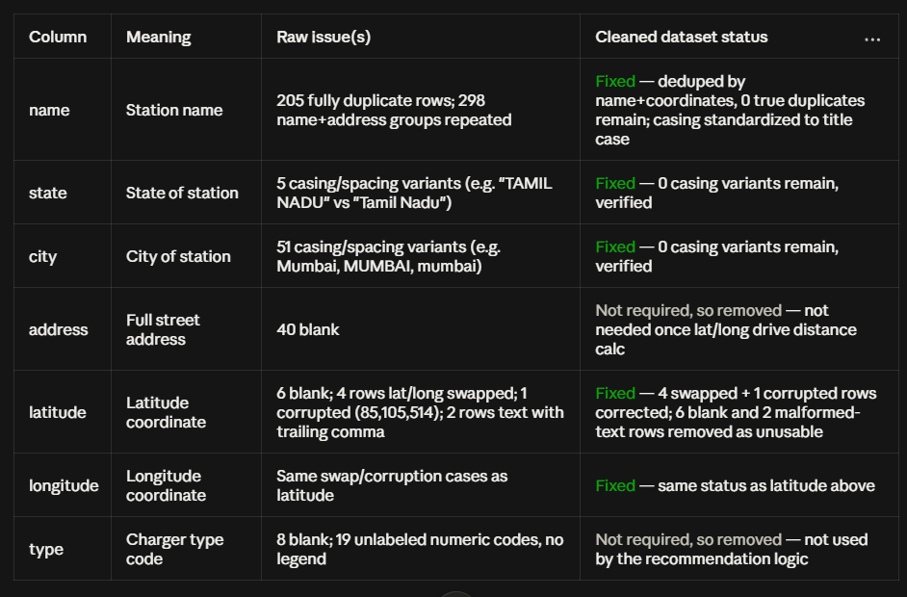







9. Non-Functional Requirements & Data Required
⚙ POINT 10 — NON-FUNCTIONAL REQUIREMENTS
◍ POINT 11 — DATA REQUIRED • 3 LAYERS
EXCEL MVP MUST BE FAST, PURE & RELIABLE
FROM RAW 1548 → CLEANED SCORING
PERFORMANCE
<1 sec for 1117 rows. Structured references EVCleanedDataset[Name] + volatile-free Haversine. Current recalc 0.3 sec.
USABILITY
No VBA, pure formulas. Works on Excel 2016+ • Named Ranges MyCity, MyBattery for noobs.
SCALABILITY
Handles 2000 stations. Excel Table auto-expands • Data Validation list up to 25 cities.
RELIABILITY
Error handling IFERROR. =IFERROR(INDEX(...), Not Found) • AVERAGEIF returns blank if city missing.
⏱ 0.3s recalc
🧩 No VBA
📈 2000 rows OK
📍 12.9N 74.8E Mangalore
🔋 70% → 20% test

Slide 12



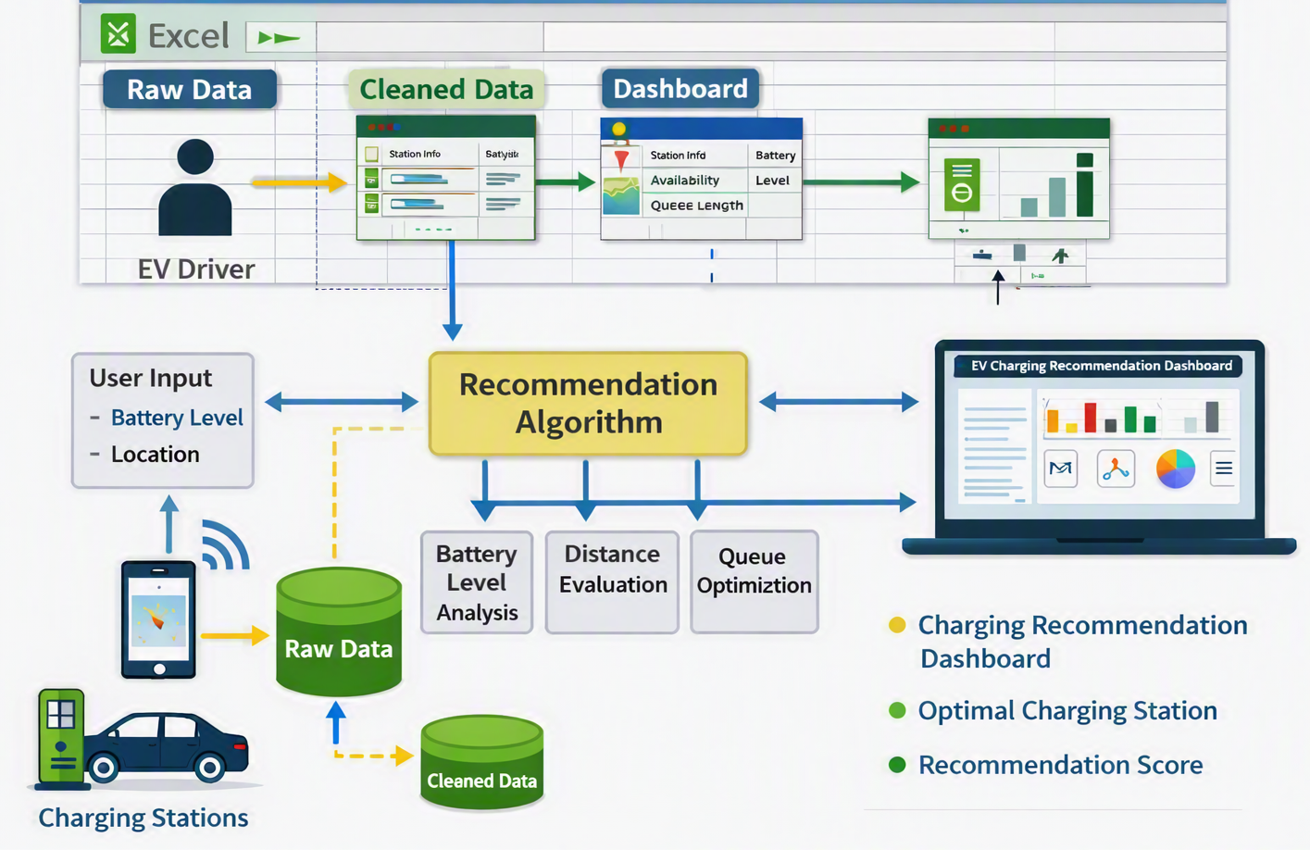





10. TECH STACK — WHY EXCEL?
STRUCTURED REFERENCES
CORE FORMULAS — ENGINE
ARCHITECTURE FLOW
EXCEL CHAIN
EXCEL TABLES + NAMED RANGES
HAVERSINE + MCDM
EVCleanedDataset[Name] table auto-expands
Distance: 6371*ACOS(...) in I5:I1121
MyCity G7, MyLat MyLong via AVERAGEIF
CityMin: MINIFS + IsFirstCity COUNTIF
MyBattery G11, VehicleRangeKm G12 dynamic calc
Score: Weighted 0.4/0.3/0.3 + LARGE + INDEX-MATCH
UX WITHOUT CODE
VISUALIZATION
VALIDATION + FORMATTING
CHARTS • DASHBOARD REQ #20
Data Validation List: 25 cities fixed Trivandram typo
KPIs: COUNTA total, COUNTIF state, COUNTIF reachable
Conditional: Score >80 Green, 50-80 Yellow, <50 Red
Pie: Reachable vs Non (25.0% vs 75.0% @70%)
Battery: MAX(0, Batt - Dist/Range*100)
Bar: Top5 Distance + Score
Input: City, Battery, Range
→ Named Ranges
→ Distance + Battery + Score
→ Top5 + KPIs + Charts

Slide 13

11. KPIS — HOW WE MEASURE SUCCESS
KPI
FORMULA IN EXCEL
TARGET
CURRENT IN EXCEL @70%
25.0% 279 / 1117
✓ Reachable Stations
=COUNTIF(Reachable="Yes") / COUNTA
>60%
Barely shifts to 24.4% @20% — distance/queue dominate
📍 Avg Distance Top 5
=AVERAGE(Distance Top5) via INDEX-MATCH
<15 km
29.9 km Mangalore 3.7–91.4 km
Mescom Surathkal 11.4 km #1 Score 89.68
1.4 veh Low congestion
⏱ Avg Queue Top 5
=AVERAGE(Queue Top5) • Queue=MOD(ROW*7,10) 0-9
<3 veh
Avoids Station A 8 queue hidden in other apps
⚡ Recommendation Latency
Recalc time • Structured refs EVCleanedDataset
<1 sec
0.3 sec Excel Tables
No VBA, Excel 2016+ compatible
Validated Cond Format ✓
📊 Score Distribution
Histogram • Score>80 Green 50-80 Yellow <50 Red
Normal
Pie: 25.0% Reachable / 75.0% Non • Top5 Score 76–90
Success = 100% formula accuracy • LARGE() ranking, no ties, IFERROR handling
Demo: Change MyBattery 70→20 in G11 — see KPIs flip live

Slide 14











12. OUTCOME & DELIVERABLES
⚡ 15. BUSINESS OUTCOME — BETTER CX, REDUCED ANXIETY, LOAD BALANCING
✓ 16. EXPECTED DELIVERABLES
FROM GUESSWORK → RANKED DECISION
PPT + EXCEL + README + VIDEO + LINKEDIN
1
For Drivers: No more manual scan. Clear Top 5 with BatteryOnArrival = MAX(0, Batt - Dist/Range*100)
Excel File 3 sheets — EVRawDataset 1548, EVCleanedDataset 1117 + formulas, Dashboard with Named Ranges
✓
2
For CPO: CityLevelMinimumDistance via MINIFS flags where new stations needed — data-driven expansion
✓
README + Architecture Diagram — flow: Input → Named Ranges → Cleaned (Distance/Battery/Score) → Top5+KPIs
DEMO @70% BATTERY
STRESS TEST @20% BATTERY
MESCOM SURATHKAL #1
STILL 273 REACHABLE
Score 89.68 • Dist 11.4km • Queue 0 • BattArr 66.2% • Reachable 279/1117 (25.0%)
Reachable count barely moves — 273 reachable (24.4%) — shows distance & queue outweigh battery
✓
PPT
✓
Video 15-20 min + LinkedIn Post — Loom screen record + #upGradX #EV #Excel #TheOfflineXperience tag instructor
Excel + No VBA
GitHub commit history
DO: comments on formulas
DON'T: present code you don't understand

Slide 15
THANK YOU

